Slide 1
DAY -1 TASK
Scenario: How to share the file from account A to account B's S3bucket??

Slide 2
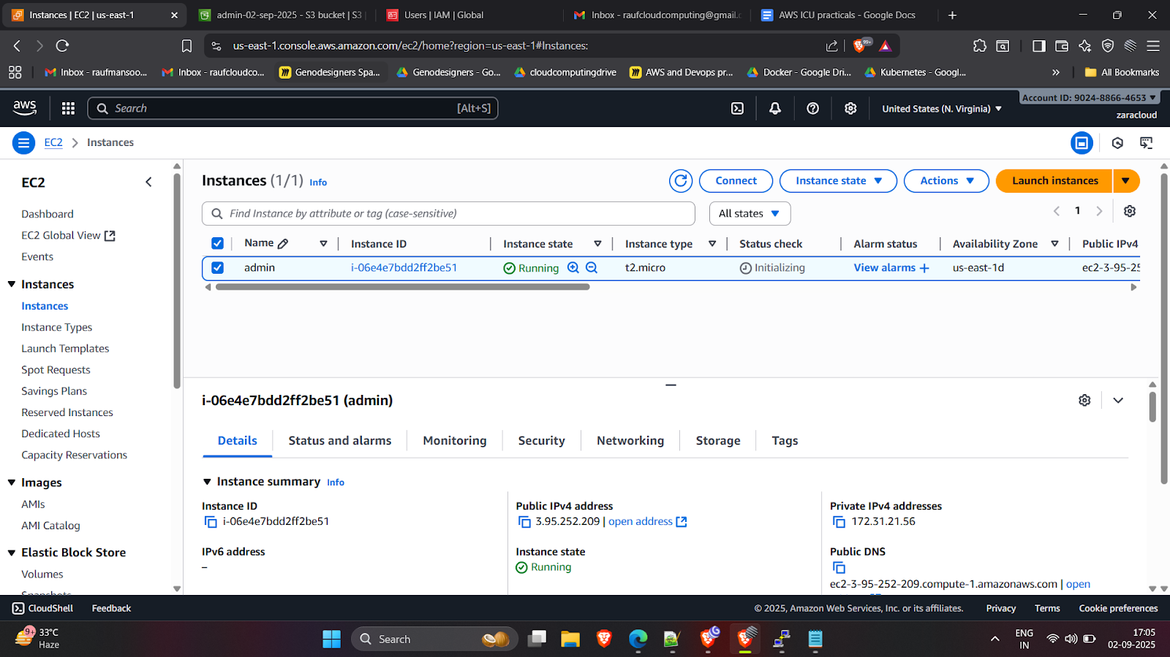
1.Create a Linux machine in EC2

Slide 3
2. Login to Putty and create a file using touch command.

Slide 4
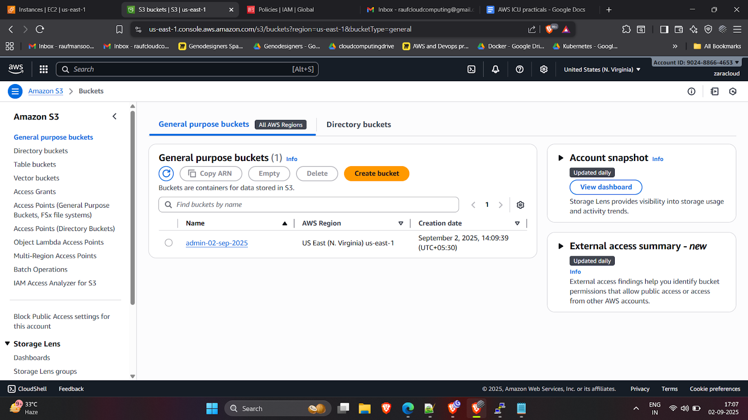
3. Create a S3 bucket to store our file

Slide 5
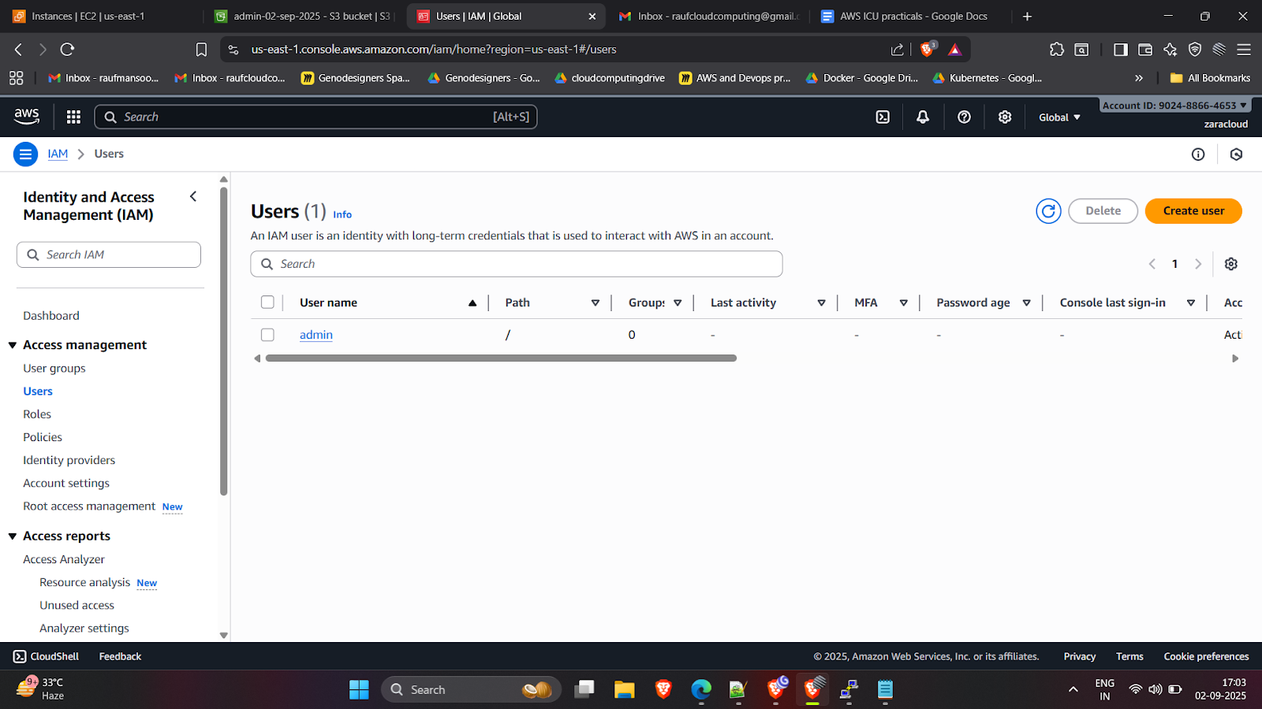
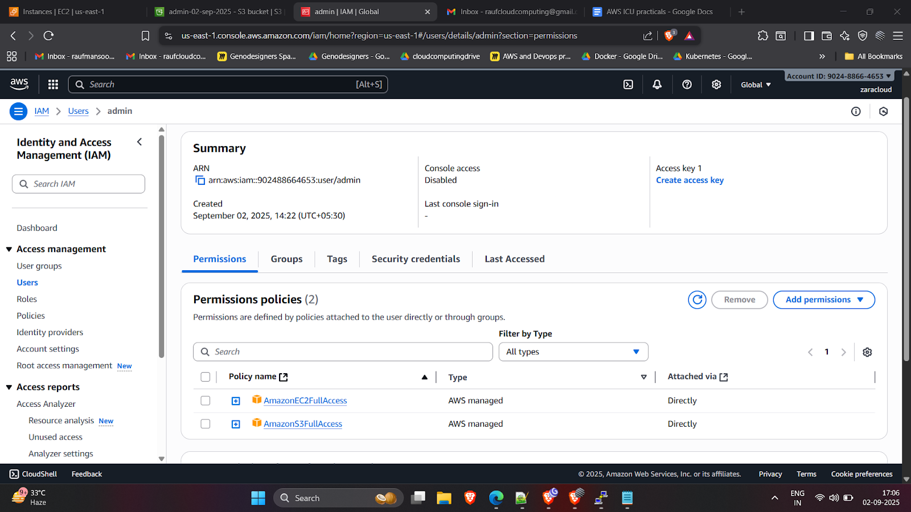
4.Create a IAM Role for EC2 access to the S3 bucket.
Give the ec2fullaccess and s3fullaccess for the user

Slide 6
6. Get the Account A's arn (arn:aws:iam::902488664653:user/admin) and go to the bucket policy in Account B and edit the bucket policy (add account A's arn)
json script for bucket policy :
{
"Version": "2012-10-17",
"Statement": [
{
"Sid": "AllowAccountAToUpload",
"Effect": "Allow",
"Principal": {
"AWS": "arn:aws:iam::678874288256:user/user1"
},
"Action": "s3:PutObject",
"Resource": "admin-02-sep-2025/*"
}
]
}

Slide 7
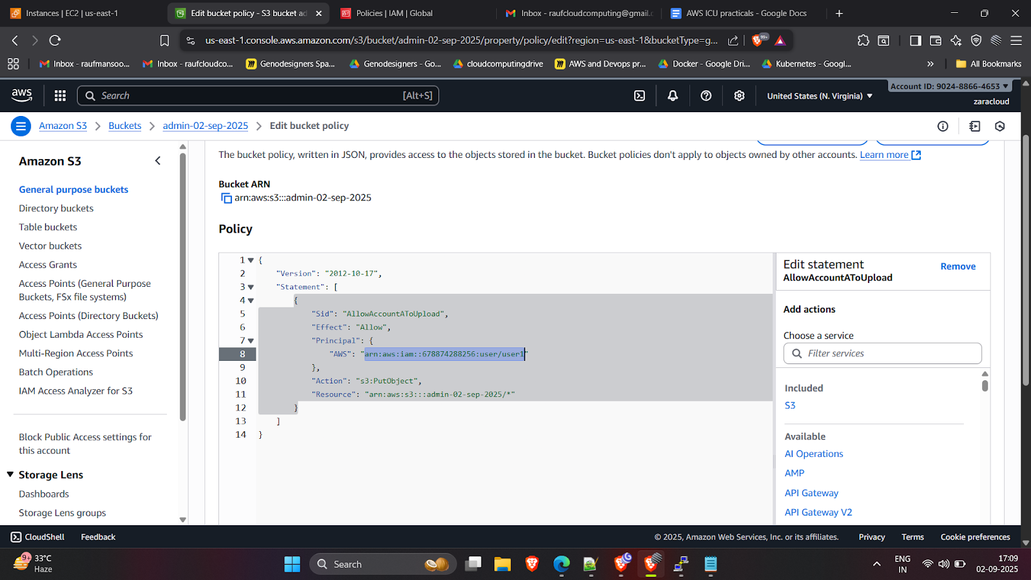
Editing bucket policy in Account B’s S3 bucket.

Slide 8
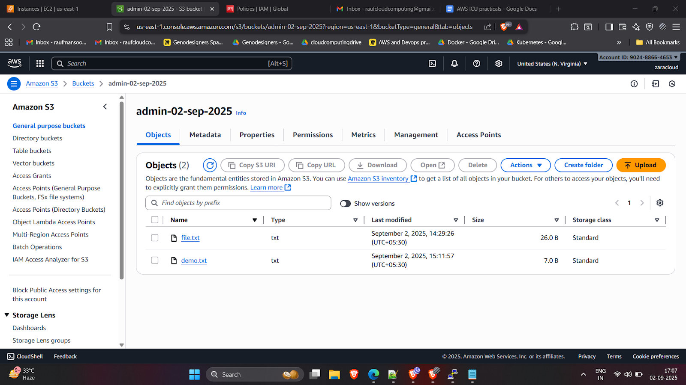
Now try to Copy the file to Account B’s S3 bucket
Once hit the below command we successfully copy the file from Account A to Account B’s S3 bucket.
aws s3 cp /home/ec2-user/filename s3://bucketname/

Slide 9
THANK YOU

